Slide 1

AI Project
Vega
Voice Assistant

Slide 2
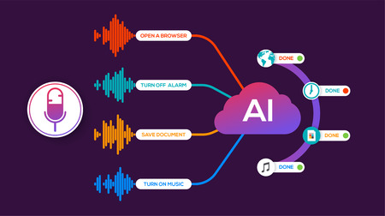
About
Vega
Vega is a program or an automated voice assistant made using GUI which is enforced with few ideas of machine learning with Python programming tool. Python enables it to work quicker and integrates the systems additional expeditiously. Vega is based on python programming which uses English keywords and different functions that are included using different modules.

Slide 3

Speech
Recognition
Speech recognition, or speech-to-text, is the ability for a machine or program to identify words spoken aloud and convert them into readable text.
It’s the procedure of extracting essential information from input speech signal to make accurate decision about the corresponding text. This concept is implemented through Python.
Rudimentary speech recognition software has a limited vocabulary of words and phrases, and it may only identify these if they are spoken very clearly.
Speak clearly or don’t speak at all.

Slide 4


A GUI (graphical user interface) is a system of interactive visual components for computer software. A GUI displays objects that convey information, and represent actions that can be taken by the user. The objects change color, size, or visibility when the user interacts with them
Graphic User Interface

Slide 5
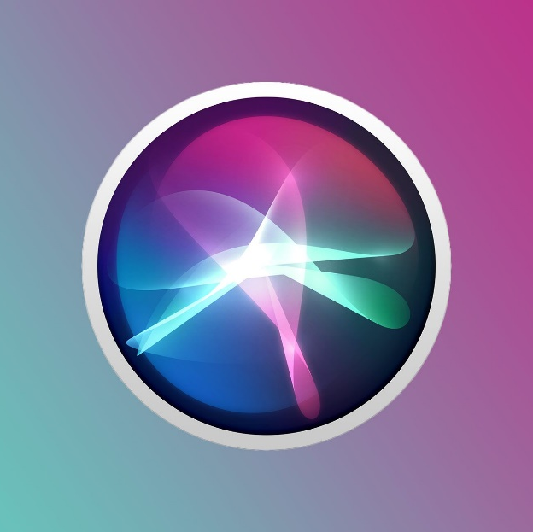
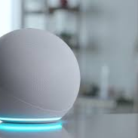

Some major
Examples
Siri : by Apple
Alexa : by Amazon
Cortana : by Microsoft
These assistant uses voice queries, gesture based control, focus tracking and a natural-language user interface to answer questions, make recommendations, and perform actions by delegating requests to a set of internet services.

Slide 6
Modules required
01
Subprocess
This module is used for getting system subprocess details which are used in various commands i.e. Shutdown, Sleep, etc. This module comes built-in with Python.
02
Wolframalpha
It is used to compute expert-level answers using Wolfram’s algorithms, knowledgebase and AI technology.
03
Pyttsx3
This module is used for conversion of text to speech in a program it works offline.
04
Wikipedia
Wikipedia is a great source of knowledge, we have used Wikipedia module to get information from Wikipedia or to perform Wikipedia search.

Slide 7
05
Tkinter
This module is used for building GUI and comes inbuilt with Python.
06
Speech recognition
Since we’re building an Application of voice assistant, one of the most important things in this is that our assistant recognizes the voice (means what you want to say).
Some extra modules:
Ecapture
Datetime
Twilio
Request
Beautifulsoup

Slide 8


Objective of our Project
Vega can make calls, send text messages, look things up online, provide directions, open apps, set appointments on our calendars, and initiate or complete many other tasks. With the addition of separate apps on the phone, our voice can be a type of remote control for our lives. You can interact with your laptop’s microphone. The response generated by Vega will display on the console in the form of text.

Slide 9
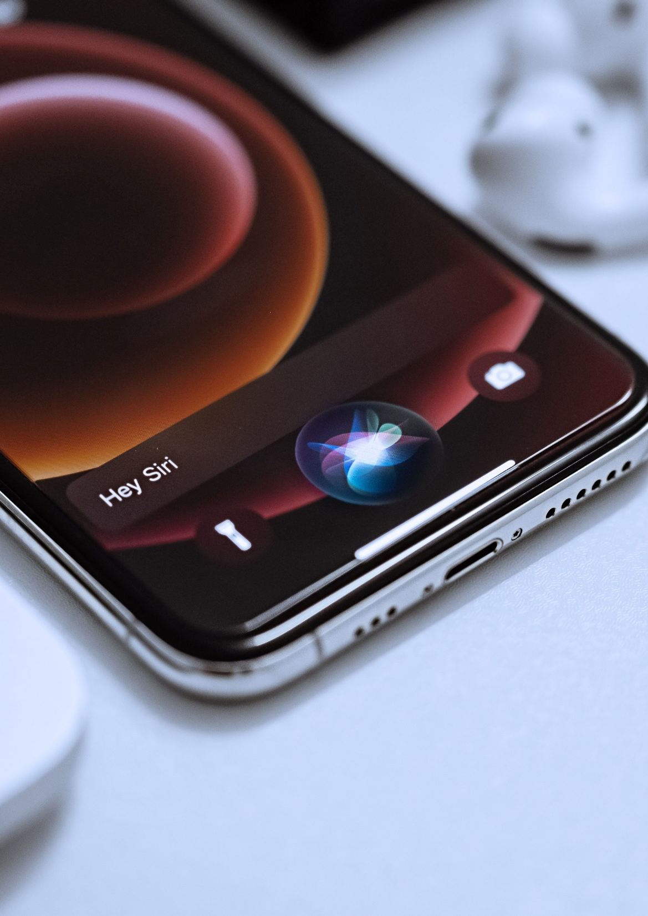
Modern Portfolio Presentation
Speech is power: speech is to persuade, to convert, to compel. It is to bring another out of his bad sense into your good sense.
Speech is Information

Slide 10
presented by
Maneesh Amoli
Uid: 20bcs2160
Satyam Kumar
Uid: 20bcs2162
Mayank Kumar
Uid: 20bcs2169
Abhishek Sambyal
Uid: 20bcs2158
Mohammad Aman
Uid: 20bcs2168
Shubham Kumar
Uid: 20bcs2214
THANK YOU

